Slide 1
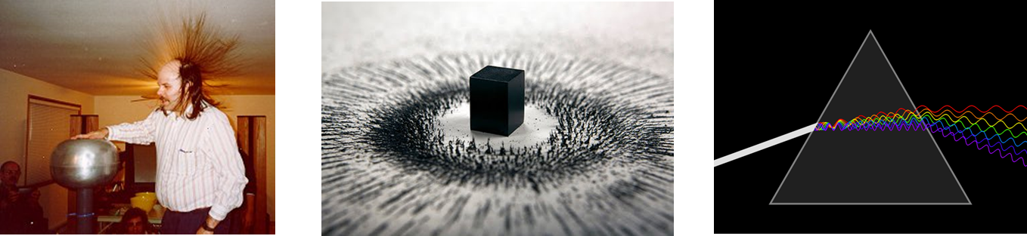
Physics 2426: Electricity, Magnetism and Light
Dr. David Stancato

Slide 2

Class Introductions

Slide 3
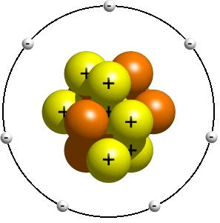
Science
Models (handout)
Constructs
Representations
Relationships

Slide 4
Physics: Theories and Experiments
Experiments
Predictions from the Models
Theoretical Models

Slide 5
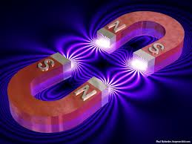
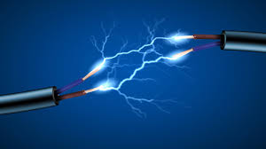
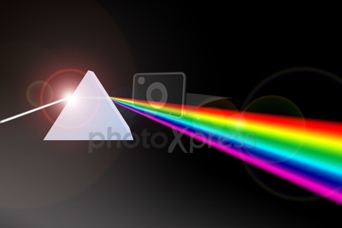
Electricity, Magnetism and Light: An Introduction

Slide 6
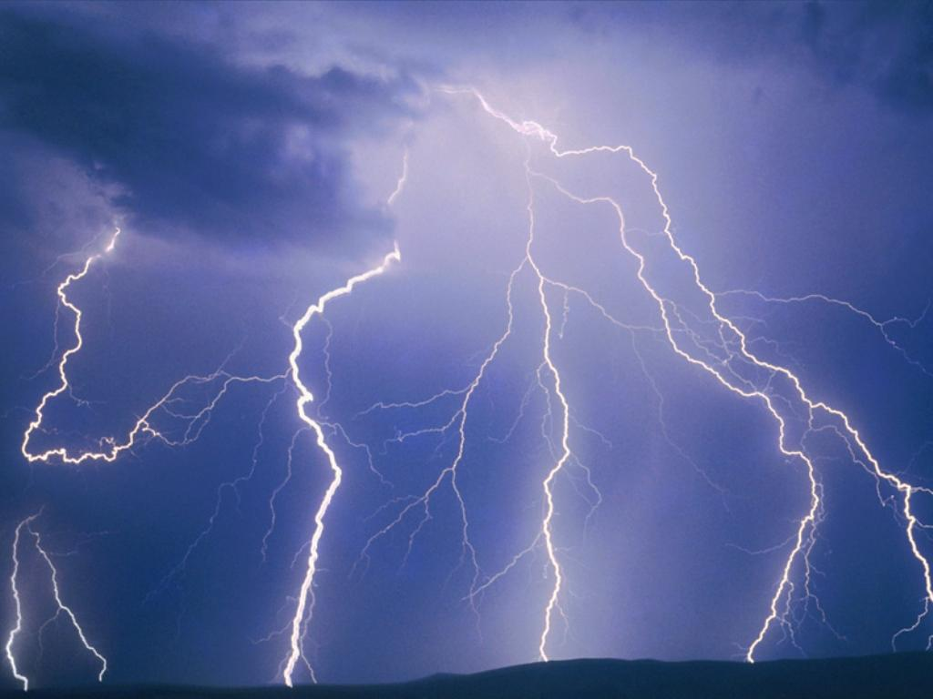
Electricity
A fundamental force of nature

Slide 7
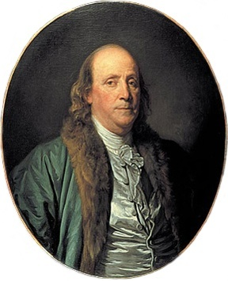
Electric Charge
A property of objects
Two types of electric charge!
Positive (+) and negative (-)
Benjamin Franklin, 1747

Slide 8
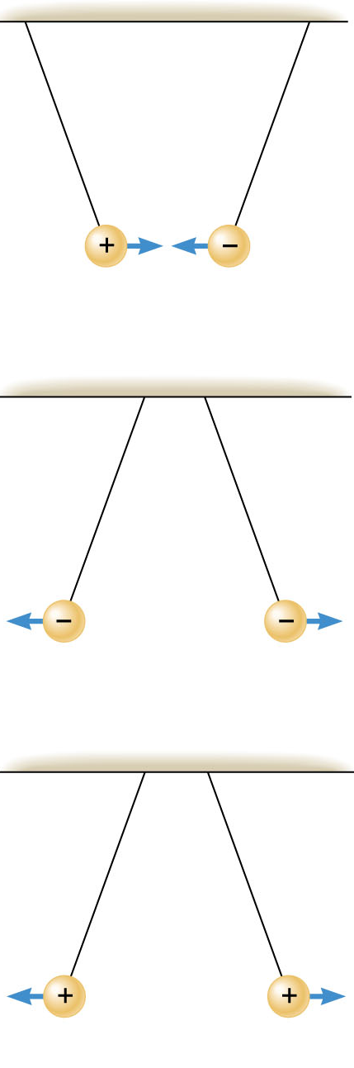
opposite charges attract (attractive force)
like charges repel (repulsive force)

Slide 9
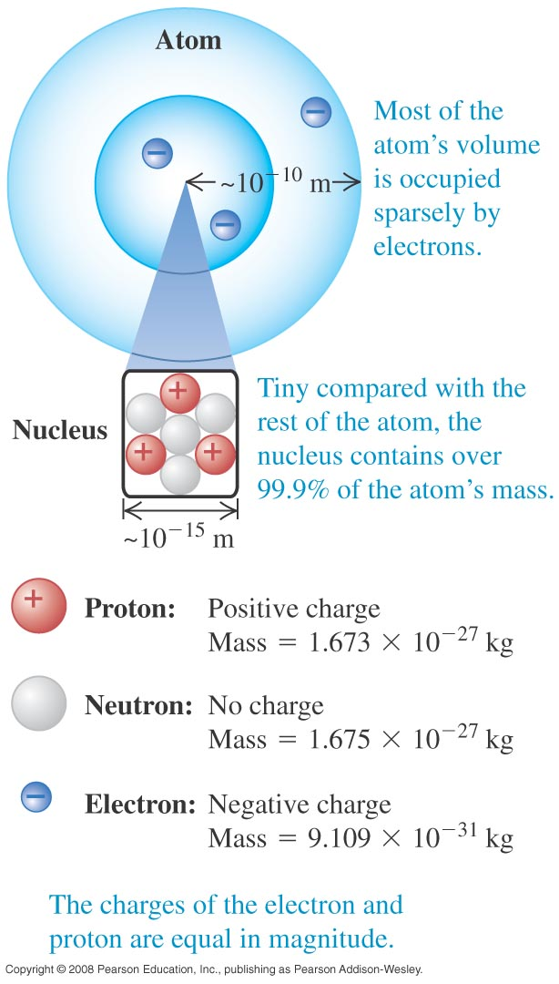
Fundamental Carriers of Charge
Atoms consist of
Electrons
Protons
Neutrons

Slide 10
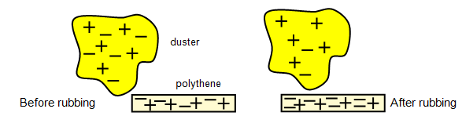
Conservation of Charge
Experimental Fact
The total amount of electric charge in a closed system is conserved!!
Charge can neither be created or destroyed!!

Slide 11
Demo: Plastic and Glass Rods

Slide 12
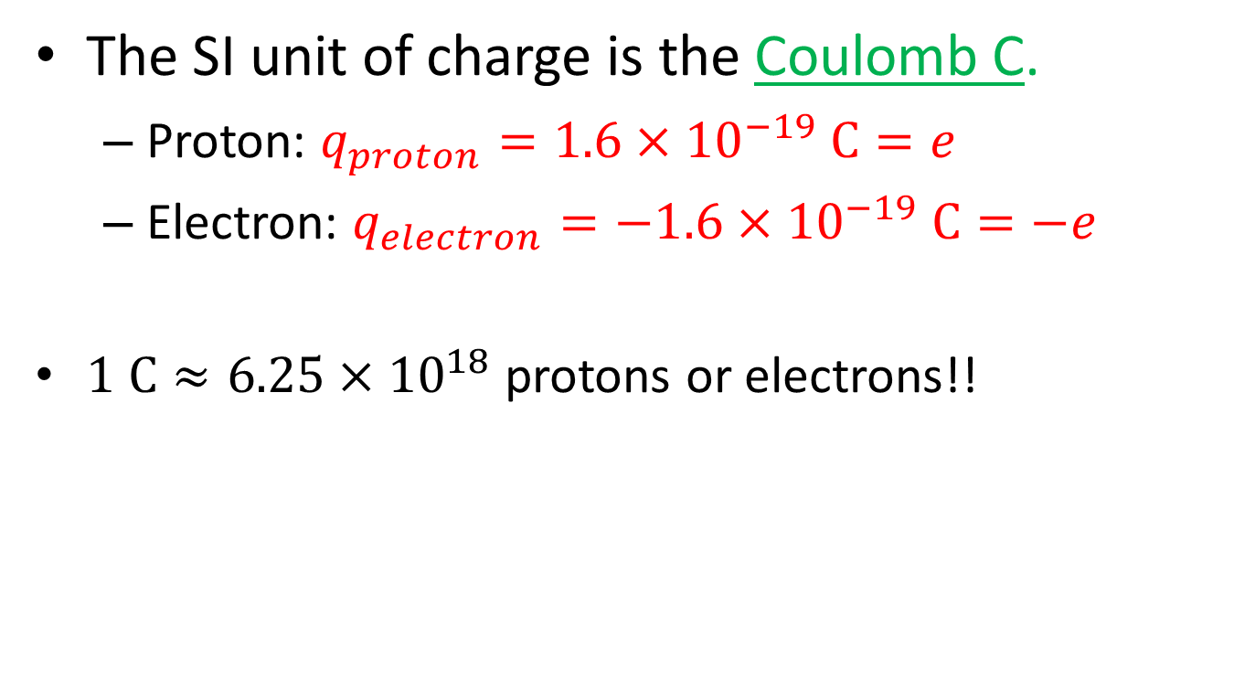
SI Unit of Charge
The SI unit of charge is the Coulomb C.
Proton: $q_{proton}=1.6×{10}^{−19} C=e$
Electron: $q_{electron}=−1.6×{10}^{−19} \text{C}=−e$
$1 \text{C}≈6.25×{10}^{18}$ protons or electrons!!

Slide 13
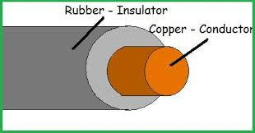
Types of Materials: Conductors and Insulators

Slide 14
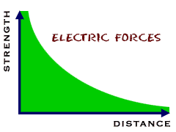
Basic Properties of the Electric Force
The larger the charges, the larger the force!
The force weakens with distance between the charges!

Slide 15
Polarization in a Conductor Visualized
DEMO: Soda Can

Slide 16
Polarization in an Insulator Visualized

Slide 17
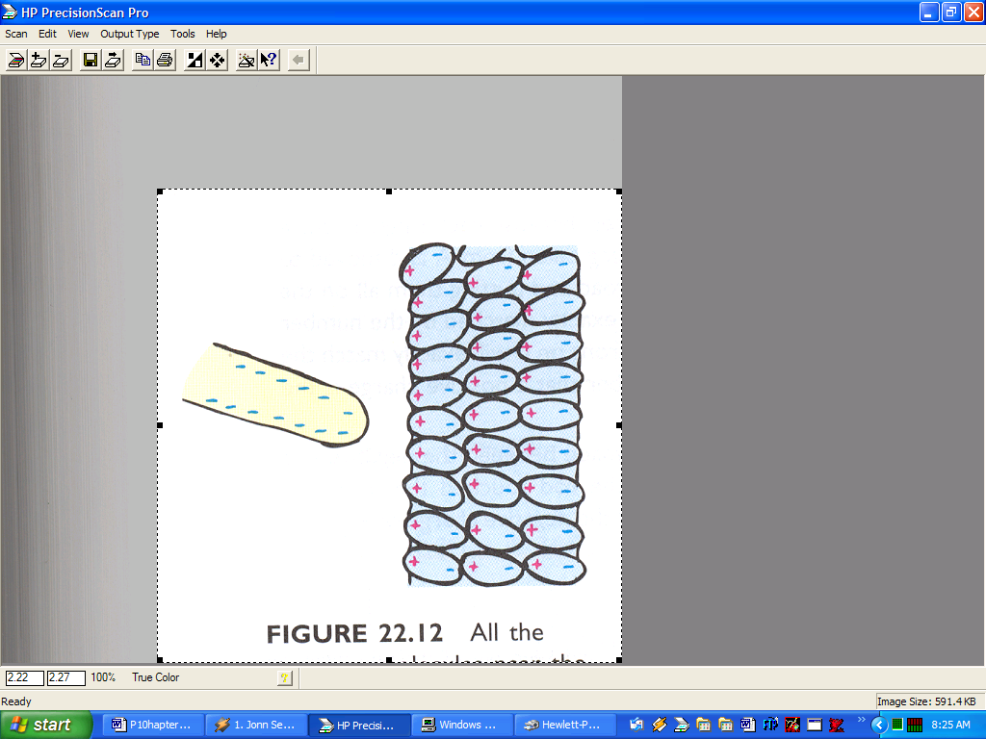
Polarization of Water: Demo

Slide 18
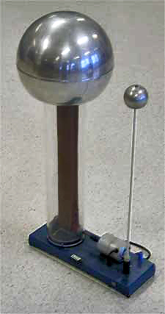
DEMO: Van de Graaff Generator!

Slide 19
Lab 1: Electric Charge

Slide 20
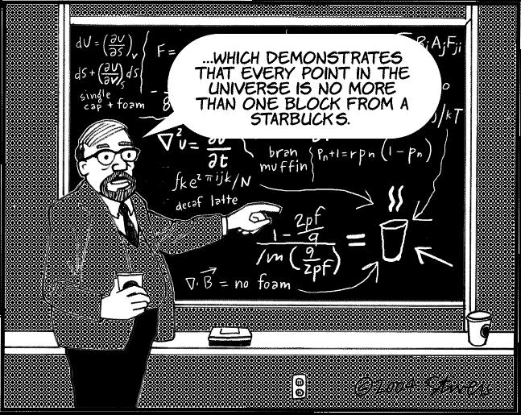
Quick Math (Vector) Review

Slide 21
Vector Operations
Adding vectors
Subtracting vectors
Vector Components
Constructing Unit Vectors
Scalar (dot) product
Vector (cross) product

Slide 22
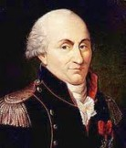
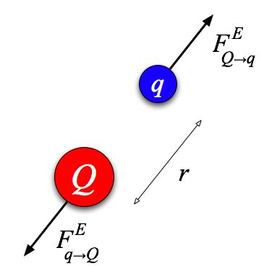
Getting Quantitative: Coulomb’s Law and Electrostatics
Charles-Augustin de Coulomb: 1736-1806

Slide 23



Coulomb’s Law
$$F_{E}=k\frac{\left|q_{1}q_{2}\right|}{r^{2}}=\frac{1}{4πε_{0}}\frac{\left|q_{1}q_{2}\right|}{r^{2}}$$
$$k=8.988×{10}^{9}\text{N}∙{\text{m}}^{2}/{\text{C}}^{2}$$
$$ε_{0}=8.854×{10}^{−12}{\text{C}}^{2}/\text{N}∙{\text{m}}^{2}$$

Slide 24
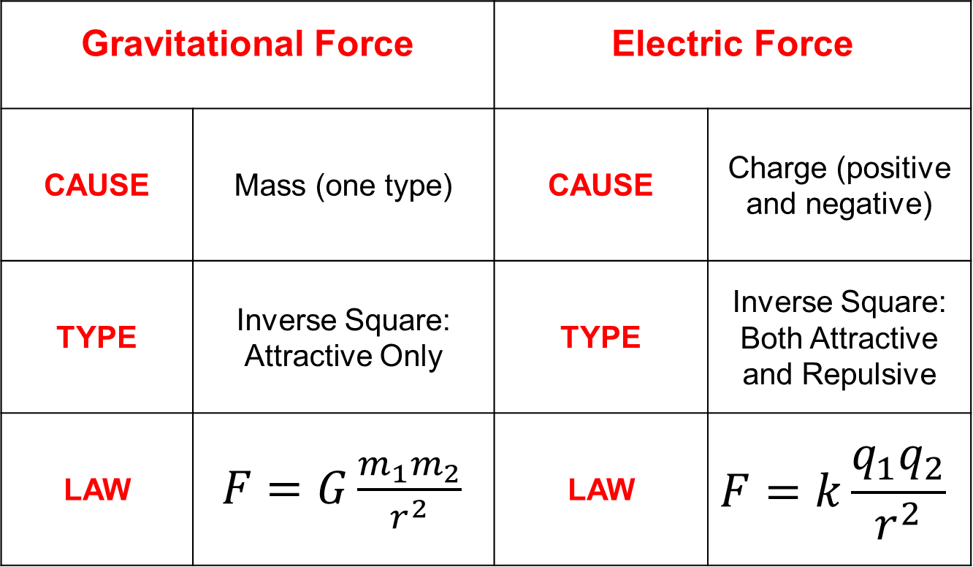
Gravitational Force |  | Electric Force
CAUSE | Mass (one type) | CAUSE | Charge (positive and negative)
TYPE | Inverse Square: Attractive Only | TYPE | Inverse Square: Both Attractive and Repulsive
LAW | $F=G\frac{m_{1}m_{2}}{r^{2}}$ | LAW | $$F=k\frac{q_{1}q_{2}}{r^{2}}$$

Slide 25
Activity: Section 1

